Slide 1

Let's have a look at what we covered yesterday
Indexes & Data Onboarding
What are Indexes?
Adding and Onboarding Data into Splunk

Slide 2


Day 03
Today’s Agenda
Dive into SPL (Search Processing Language)
What is SPL?
Basic SPL Commands and Real-world Use Cases

Slide 3
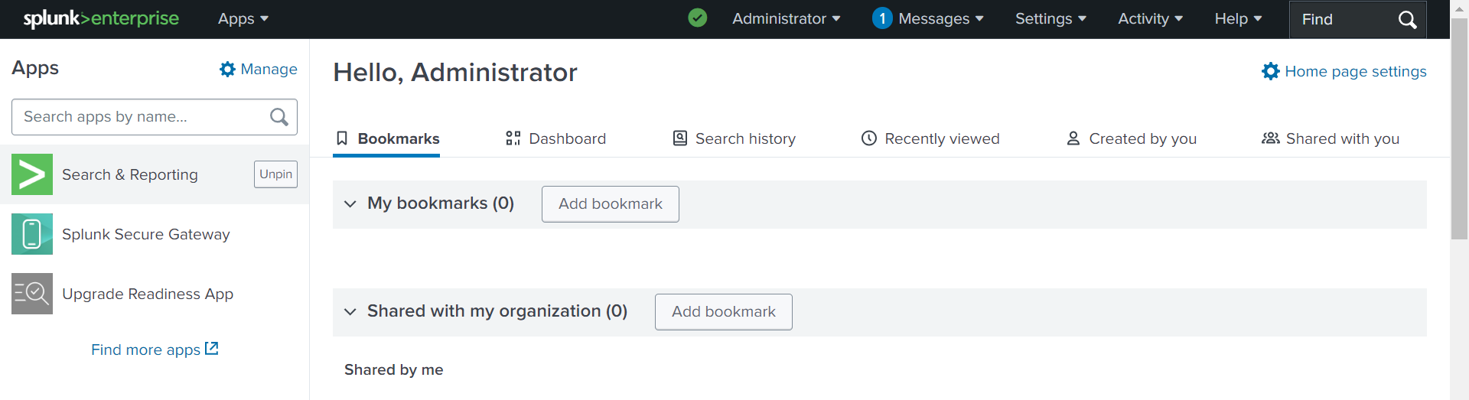
What is Search Processing Language?
SPL (Search Processing Language) is Splunk's query language used for searching, analyzing, and visualizing data stored in Splunk indexes. It allows users to interact with and extract meaningful information from the large volumes of machine-generated data that Splunk collects.

Slide 4
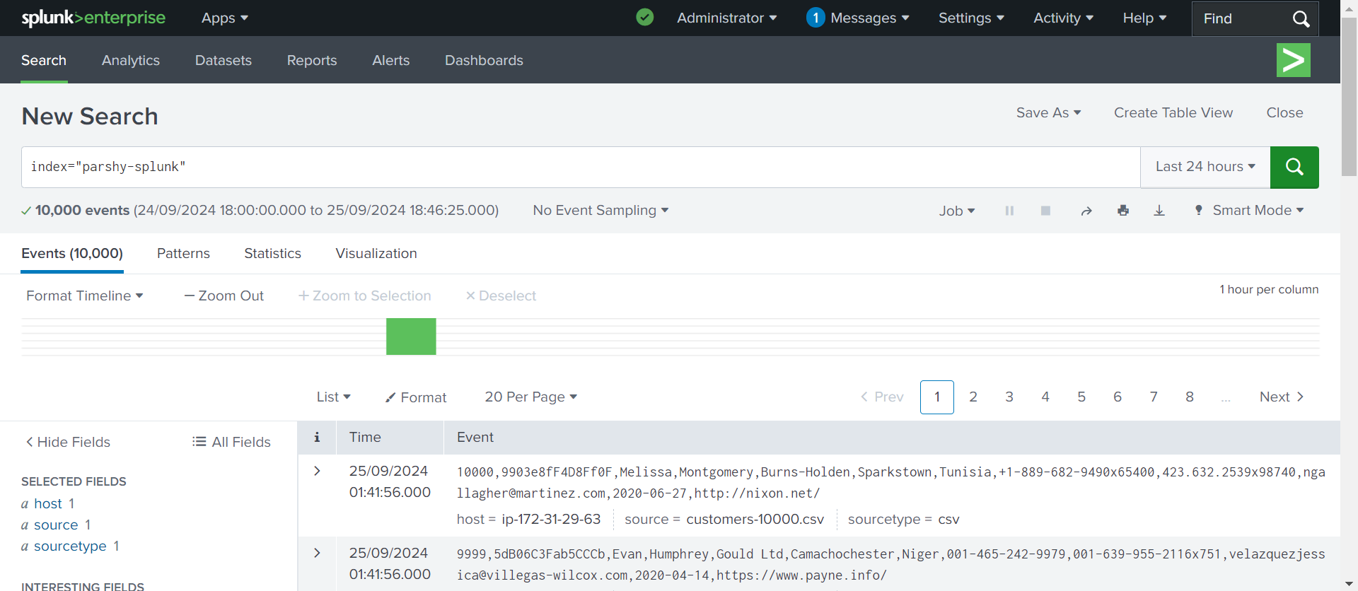
Basic Search
index=<index_name> For example: index=parshy-splunk
index=<index_name>
You can add keywords to refine your search:

Slide 5
Time Range:
index=<index_name> earliest=<value of time> For example: index=parshy-splunk earliest=-24h Common time modifiers include:
earliest=-7d (last 7 days)
earliest=-15m (last 15 minutes)
earliest=-1h@h (the last complete hour)
earliest=-1d@d (the last complete day)

Slide 6
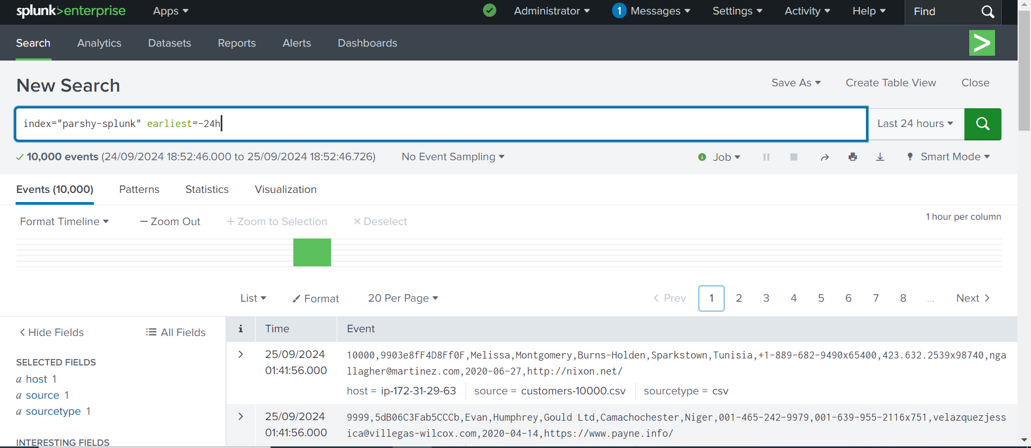

Slide 7
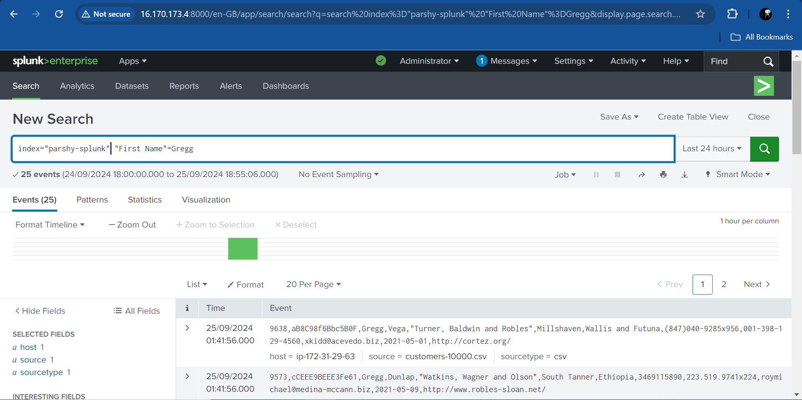
Filtering by Fields:
index=<index_name> field=value For example: index=parshy-splunk “First Name”=Gregg

Slide 8
Using stats Command:
The stats command is powerful for aggregating data. You can use it to calculate metrics like count, sum, average, etc. index=<index_name> | stats count by <field_name>
index=<index_name> | stats avg(<field_name>) For example: index=_internal | stats count by sourcetype

Slide 9
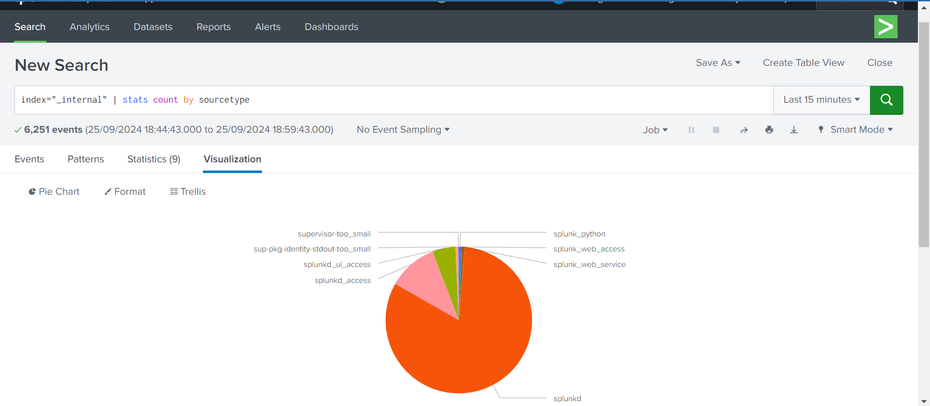

Slide 10
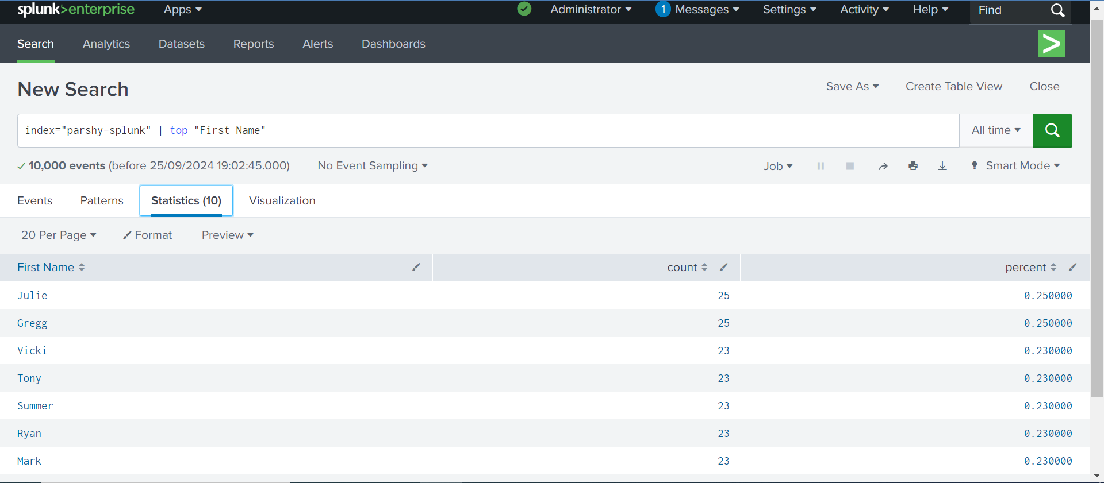
Top Values
index=<index_name> | top <field_name> For example: index=parshy-splunk | top “First Name”

Slide 11
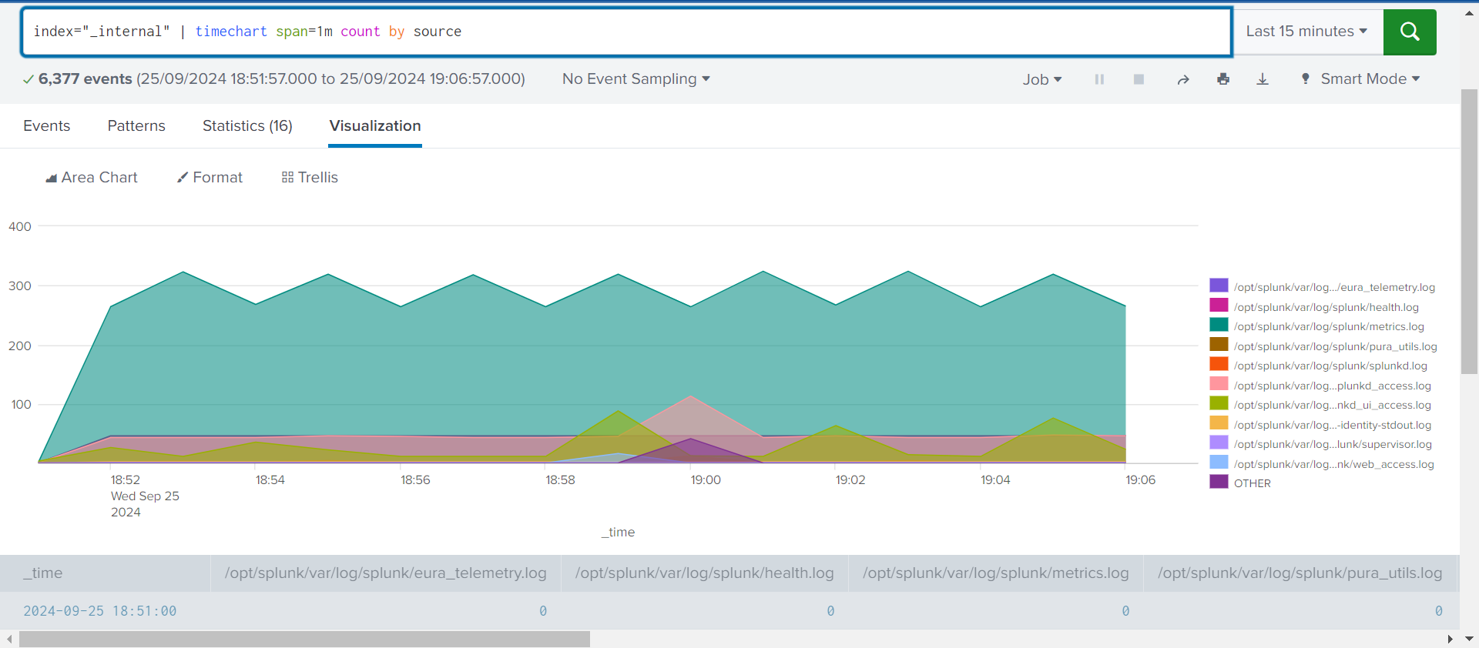
Timechart for Visualization
index=<index_name> | timechart count by <field_name>
For example: index=main | timechart count by status

Slide 12
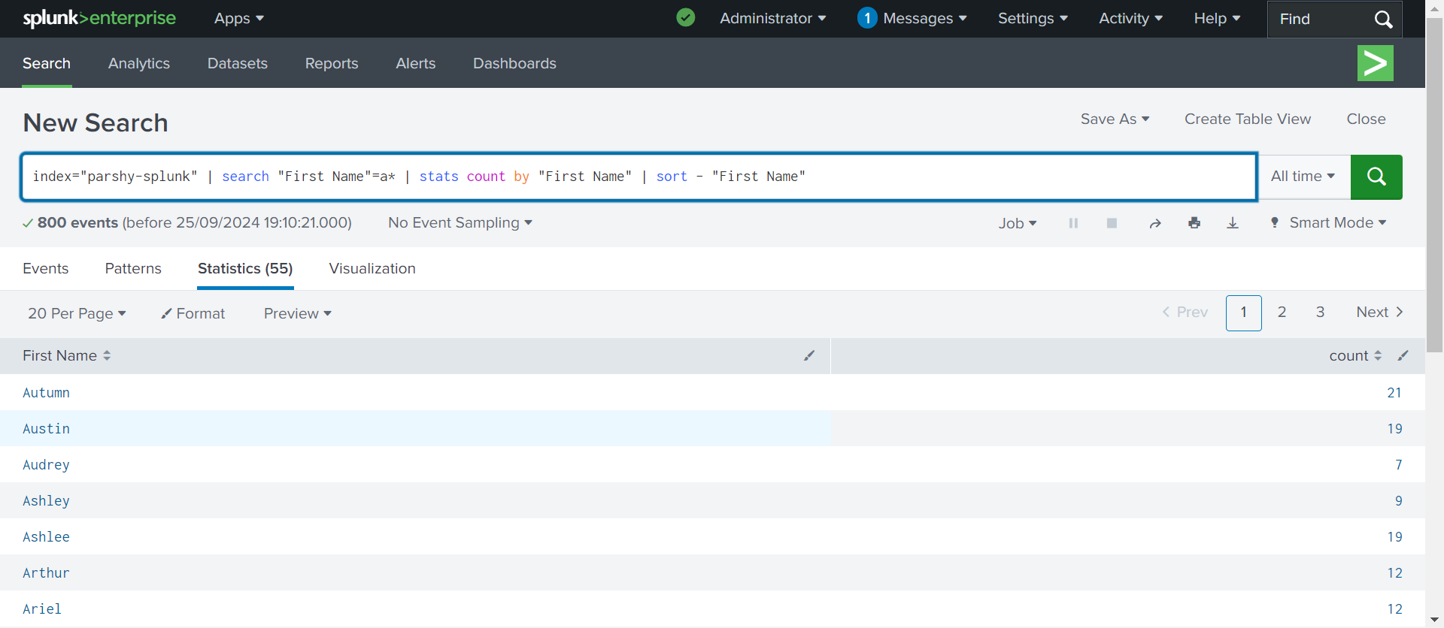
Sorting Results
index=<index_name> | sort - <field_name>

Slide 13
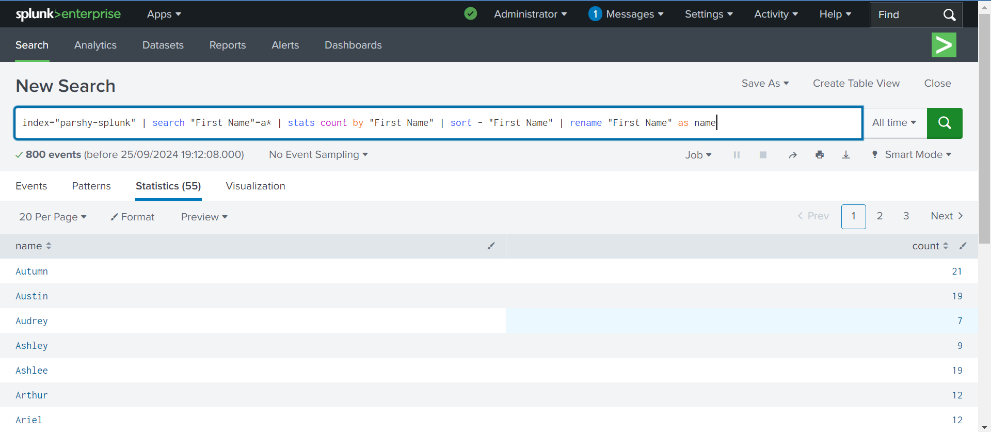
Renaming Fields

Slide 14
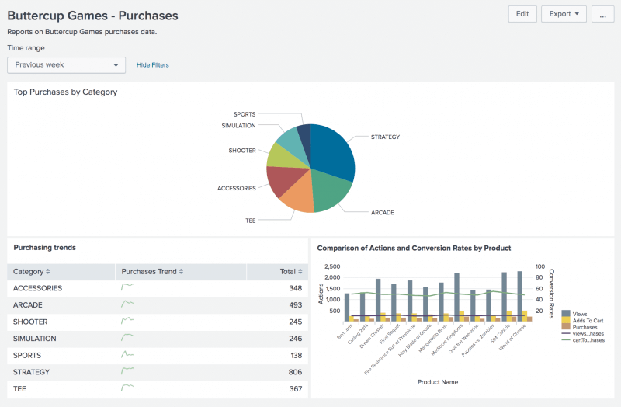
What is Dashboard?
The dashboards are views which consist of panels. The panels can include such modules as search boxes, fields, maps, tables, and lists

Slide 15
Create a Dashboard:
Start a new search.
Change the time range to the Previous week.
Run the following search.
Click the Visualization tab. The displays shows a Line Chart.
Change the Line Chart to Pie Chart.
Click Save As and select the Dashboard.
Fill all the details necessary to add in dashboard.
Click Save.
In the confirmation dialog box, click View Dashboard.

Slide 16
Add Panels to existing Dashboard:
There are two ways to add panels in dashboard
● Using Add panel option when you edit the
Dashboard
● You can create a search and then Save in existing
Dashboard.

Slide 17
Cheat sheet for splunk:
https://www.splunk.com/en_us/blog/learn/splunk-cheat-sheet-query-spl-regex-commands.
html#:~:text=Search%20Processing%20Language%20(SPL)
Below link helps you to write splunk queries:
https://gosplunk.com

Slide 18
What’s Coming Next?
Configuration & Data Handling
Splunk Configuration Files
How Data is Handled in Splunk
Concept of Basic Forwarding

Slide 19
THANK YOU

